Slide 1


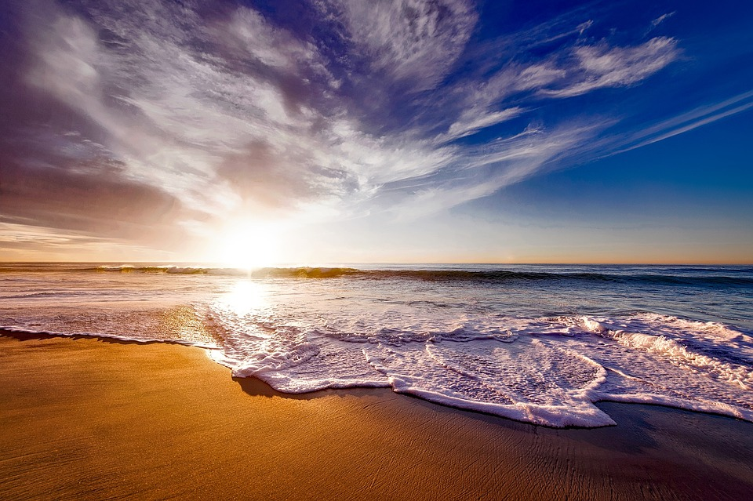
Introductory Meeting
MIC
Smart Beach
CRYdata Solutions:
Cassandra Forlani
Ruwindhu Dilanga Chandraratne Hettige Don
Yi-Chen Hsiao
Notes:
Image: 12019 (2016) Ocean waves crashing on shore during daytime https://pixabay.com/photos/beach-sea-sunset-sun-sunlight-1751455/

Slide 2

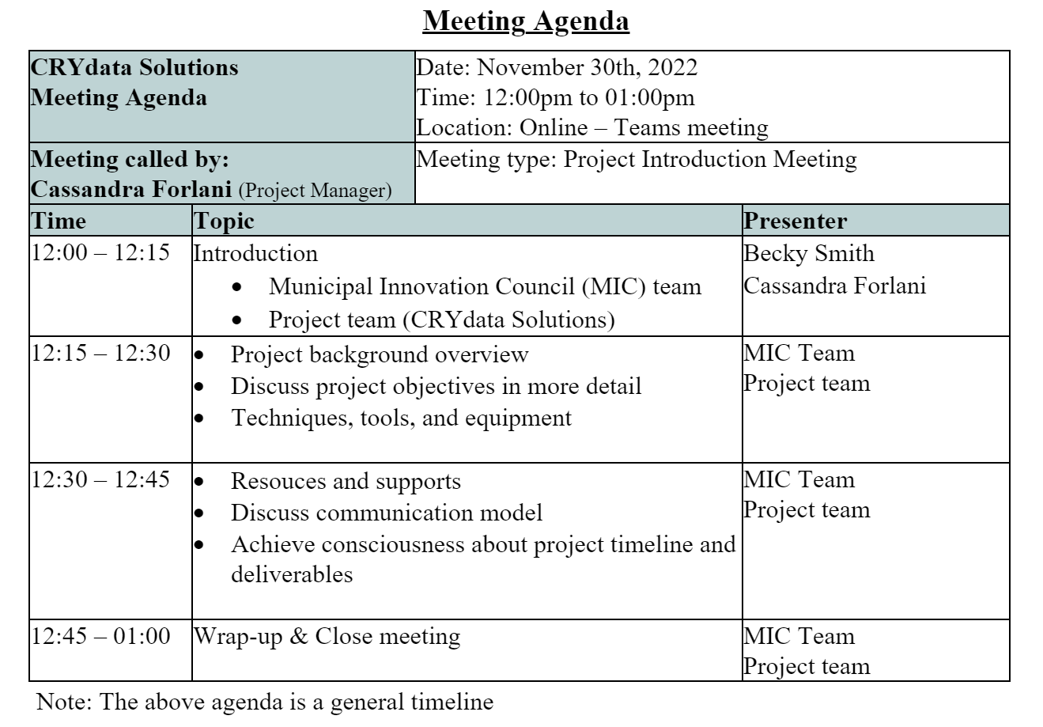
Agenda
Notes:
Image: from free image website - unsplash (https://unsplash.com/)

Slide 3


Introduction
Notes:
Image: from SAOLA SHOES website (https://saolashoes.com/)

Slide 4
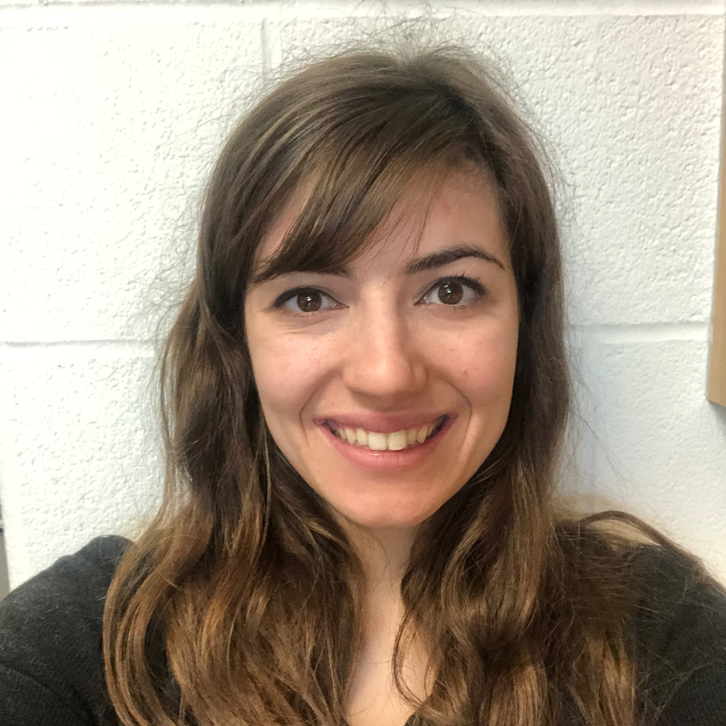
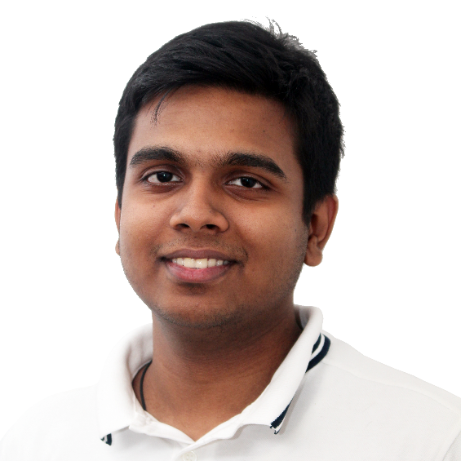
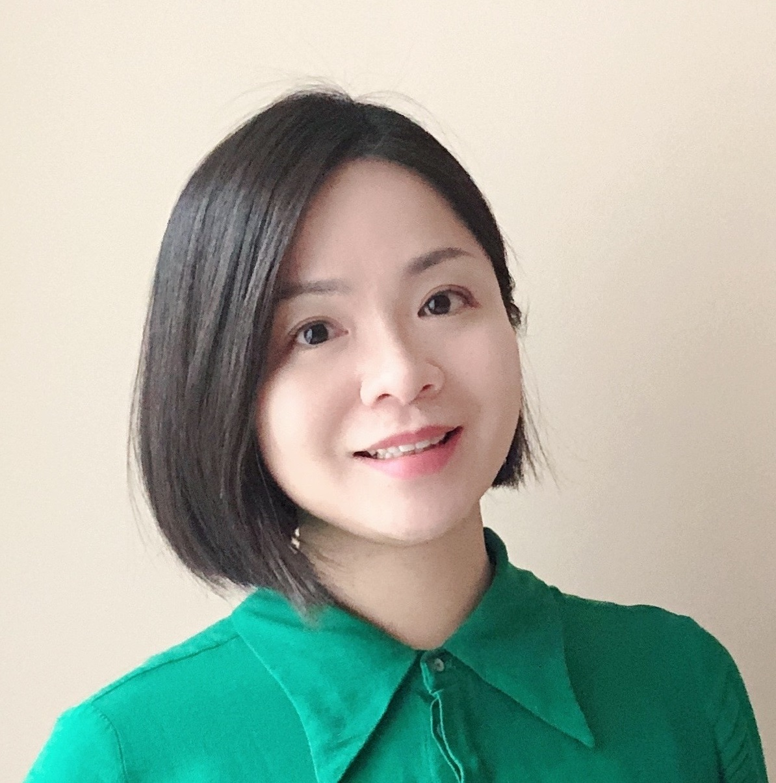
CRYdata Solutions
Our Team
Cassandra
Forlani
Ruwindhu Dilanga Chandraratne Hettige Don
Yi-Chen
Hsiao
Project Manager
Developer
Analyst

Slide 5

Who we are
I have a bachelor of math from Waterloo University and a Bachelor of Education from Western University. Prior to the Big Data Analysis program at Georgian College, I was a high school math teacher. In terms of skills, I have high communication and organization with entry level python and Hadoop/hive coding
LinkedIn: https://ca.linkedin.com/in/cassandra-forlani
I have a Bachelor’s in Software Engineering and Post Graduate Certificate in Artificial Intelligence. Prior to the Big Data Analytics Program at Georgian College, I have experience using Python for Machine Learning and Neural Networks. In addition to this, I have 2 years of experience working as a Software Engineer where I worked with different programming languages such as C++ and C#. In terms of skills, I have worked in many agile teams and have a thorough understanding of agile development processes.
LinkedIn: https://ca.linkedin.com/in/ruwclk
I earned my Ph.D. in the health science field in 2018 in Taiwan, with a solid quantitative and qualitative methods training background, and I have some articles published in international journals (SSCI/SCI). Before studying in the BDAT program, I accumulated many years of experience helping clients make data-driven decisions. Additionally, I co-founded a non-profit in Taiwan, helping entrepreneurs make good use of data. I am adept at market research and predictive models and familiar with various tools (SPSS, Python, R, Power BI, Apache-Hive).
LinkedIn: https://ca.linkedin.com/in/yi-chen-hsiao

Slide 6
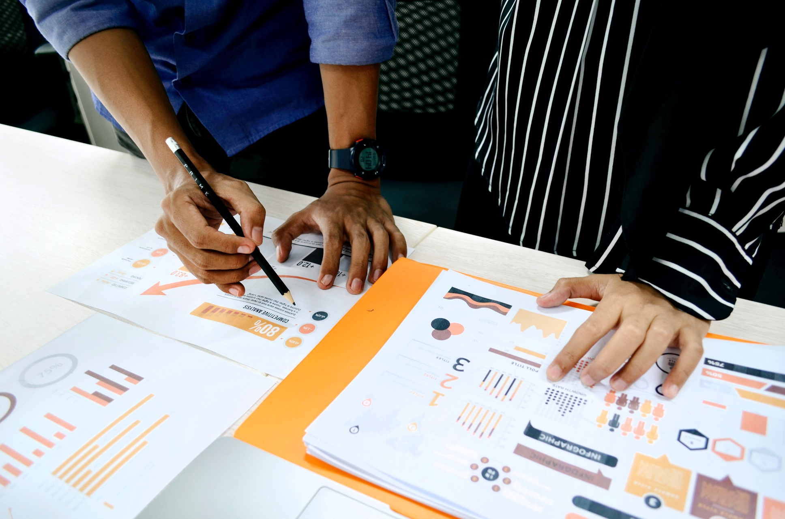
Project Overview
Notes:
Image: from free image website - unsplash (https://unsplash.com/)

Slide 7
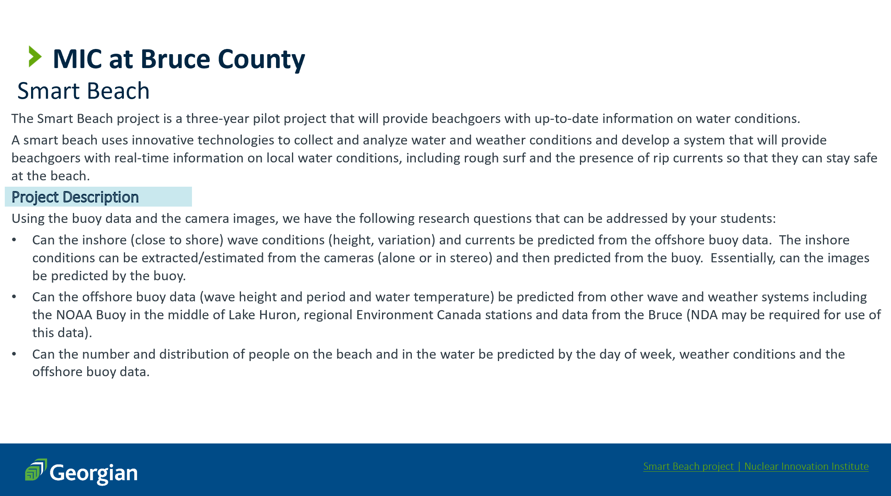

Slide 8
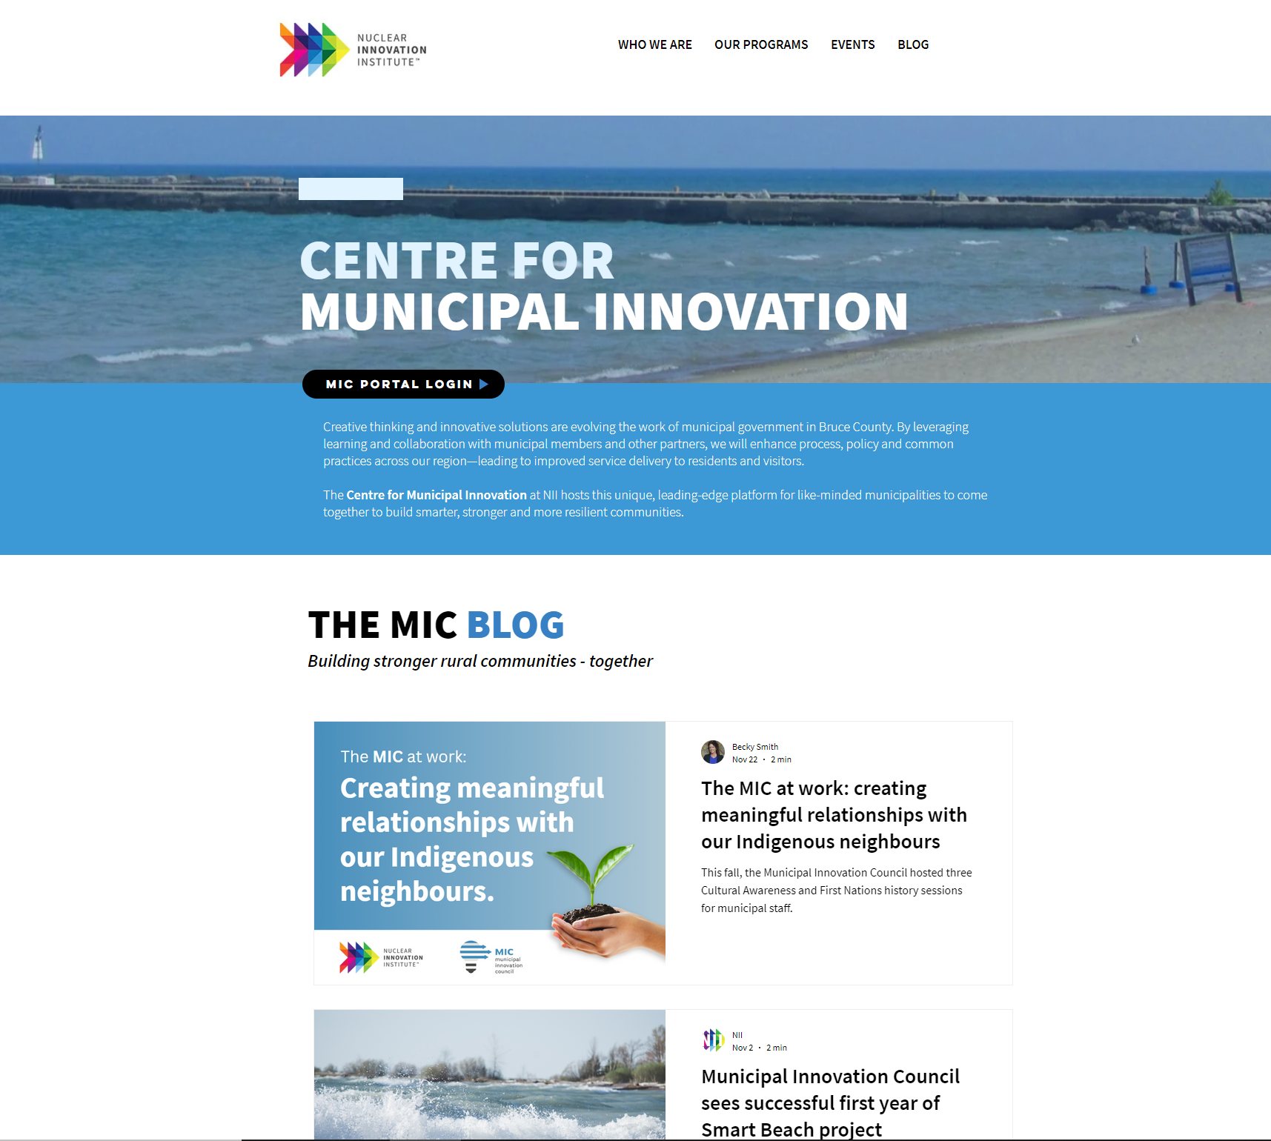

External Research via The MIC Blog
Warning system
Provides safety notice to beachgoers
Includes information regarding local water conditions, rough surf and presence of rip currents
Machine learning
Will use wave, current and wind data accumulated with a RAEON buoy
Anonymized images to understand how wave conditions affected peoples use of water and if beach access design strategies promoted safer water activities
What is next
Communication tool
Build on Awareness
Further expand project
NII Centre For Municipal Innovation - The MIC BLOG https://www.nuclearinnovationinstitute.ca/municipal-innovation
NII (Nov 2, 2022) Municipal Innovation Council sees successful first year of Smart Beach project https://www.nuclearinnovationinstitute.ca/post/municipal-innovation-council-sees-successful-first-year-of-smart-beach-project

Slide 9
Questions we have:
Will we focus on all beaches surrounding Lake Huron or only focus on specific beaches? (For example, the beaches they have collected data – what are those beaches?)
Do you have the data about the number of people on the beach or do we need to know that from images as well?
Is there any available public dataset regarding this?
Are the safe definitions different for different kinds of beach activities?
Will we be combining two data sets or be focusing on one?
Regarding following questions:
Predict water conditions for safety
Predict how many people are on the beach based on day of week, weather, etc.
Notes:
Image: from free image website - unsplash (https://unsplash.com/)

Slide 10

Thank you!
Questions?
Notes:
Image: Leloo, The first (2022) https://www.pexels.com/photo/question-marks-on-paper-crafts-5428833/

